Slide 1
Java Memory Model

Slide 2
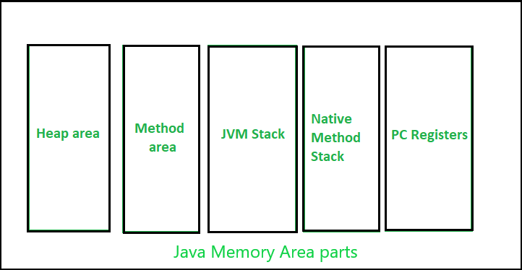
Memory model

Slide 3
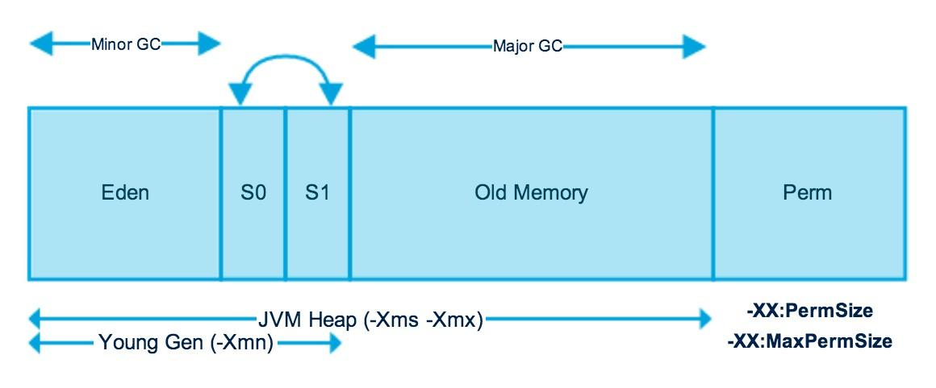
Heap Memory

Slide 4
Garbage Collection
The JVM heap is physically divided into two parts: nursery (young generation) and old space (or old generation)
The nursery is a part of the heap reserved for the allocation of new objects.
When the nursery becomes full, all the objects that have lived long enough in the nursery are promoted (moved) to the old space, thus freeing up the nursery for more object allocation
This garbage collection is called Minor GC.
The nursery is divided into three parts – Eden Memory and two Survivor Memory spaces
When old space is full, Major GC happens

Slide 5
Garbage Collection
Most of the newly created objects are located in the Eden Memory space
When Eden space is filled with objects, Minor GC is performed and all the survivor objects are moved to one of the survivor spaces
Minor GC also checks the survivor objects and moves them to the other survivor space.
So at a time, one of the survivor space is always empty
Objects that have survived many cycles of GC, are moved to the old generation memory space.
Usually, it is done by setting a threshold for the age of the nursery objects before they become eligible to promote to the old generation

Slide 6
Setting memory sizes
-Xms sets initial heap size
-Xmx sets maximum heap size
-XX:PermSize sets initial size of permgen
-XX:MaxPermSize sets maximum size of permgen
-XX:NewSize sets initial size of young generation
-XX:MaxNewSize sets max size of young generation
-Xss sets the size of thread stack for each thread

Slide 7
JVM flags - example
-Xms2560m
-Xmx2560m

Slide 8
Class Loading Activities
Java’s dynamic class loading functionality is handled by the Class Loader SubSystem.
It loads, links and initializes the class when it refers to a class for the first time
Class Loader SubSystem is responsible for following 3 activities
Loading
Linking
Initialization

Slide 9
Illustration
public class Test {
public static void main(String[] arg) {
String s = new String("Pumpkin");
Student s1 = new Student();
}
}
For the above class, class loader loads
Test.class
Object.class – parent class
String.class
Student.class

Slide 10
Types of Class Loaders
Class Loader Subsytem contains following three types of class Loaders
Bootstrap Class Loader or primordial Class Loader
Extension Class Loader
Application Class Loader or System Class Loader

Slide 11
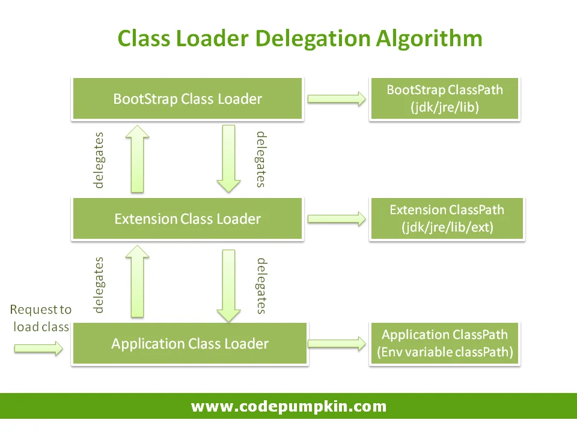
Class Loading Mechanism (contd)

Slide 12
CustomClassLoaders
Custom class loaders are helpful for more than just loading the class during runtime.
A few use cases might include:
Helping to modify the existing bytecode
Creating classes dynamically suited to the user’s needs, e.g. in JDBC, switching between different driver implementations is done through dynamic class loading.
Implementing a class versioning mechanism while loading different bytecodes for classes with the same names and packages
Getting class code from network

Slide 13
CustomClassLoaders
public class CustomClassLoader extends ClassLoader {
@Override
public Class findClass(String name) {
byte[] b = loadClassFromFile(name);
return defineClass(name, b, 0, b.length);
}
private byte[] loadClassFromFile(String fileName) {
}
}

Slide 14
Profilers
A Java Profiler is a tool that monitors operations at the JVM level
These code constructs and operations include object creation, thread executions, memory usage and garbage collections
Some known profilers:
Jprofiler
Yourkit
Java VisualVM
the NetBeans Profiler
the IntelliJ Profiler.

Slide 15
Memory Leaks

Slide 16
Mutable static fields
Static fields are never garbage-collected!
For convenience alone, static fields and collections are often used to hold caches or share state across threads.
Mutable static fields need to be cleaned up explicitly.
The cleanup will not take place, resulting in a memory leak.
Never use mutable static fields—use only constants.
If you need mutable static fields, make sure of tracking them or try some other technique

Slide 17
Thread Pool
The Thread Pool pattern helps to save resources in a multithreaded application and to contain the parallelism in certain predefined limits
When we use a thread pool, we write our concurrent code in the form of tasks and submit them for execution to an instance of a thread pool.
This instance controls several re-used threads for executing these tasks

Slide 18
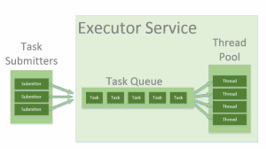
Thread Pool

Slide 19
ThreadLocal Memoy Leaks
ThreadLocals are supposed to be garbage collected once the holding thread is no longer alive.
But the problem arises when we use ThreadLocals in Thread pools
Modern application servers use a pool of threads to process requests, instead of creating new ones
If any class creates a ThreadLocal variable, but doesn’t explicitly remove it, then a copy of that object will remain with the worker Thread
ThreadLocals provide the remove() method, which removes the current thread’s value for this variable

Slide 20
Problem with large classes
At times it is possible to have a class with lot of static variables and methods
These classes occupy lot of memory
Split these classes into smaller classes so that only those classes which are being used remain in the memory and the other classes are unloaded when not used

Slide 21
Coding Techniques

Slide 22
Understanding Collections
Interface | Class | Synchronized?
Set | HashSet | No | Fastest Set; slower than HashMap but implements the Set interface (HashMap does not)
 | TreeSet | No | Slower than HashSet; provides iteration of keys in order
Map | HashMap | No | Fastest Map
 | Hashtable | Yes | Slower than HashMap, but faster than synchronized HashMap
 | TreeMap | No | Slower than Hashtable and HashMap; provides iteration of keys in order
List | ArrayList | No | Fastest List

Slide 23
Optimize the code
Understand String class
Understand StringBuilder and StringBuffer classes
Use regex for string complex comparisons
Avoid BigInteger and BigDecimal
Avoid large methods
Avoid large classes (split them)
Understand primitives vs Wrappers
Database connection pooling
Use PreparedStatement instead of Statement in JDBC

Slide 24
Recursion
Recursion is good in solving complex problems where loops cannot be used
However, you should use recursion sparingly
In the iterative approach, the local variables are created once.
However, in the case of the recursion, for each method call a stack frame with local variables is created.
The rule is – do not use recursion if loops can be used

Slide 25
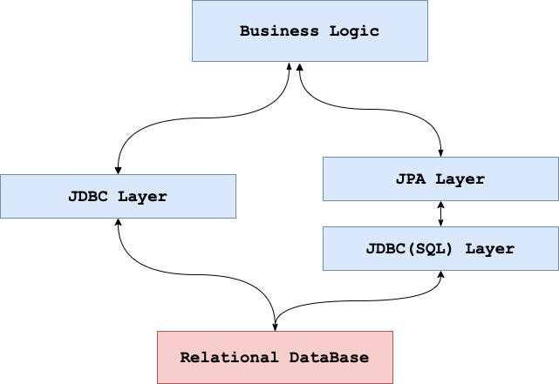
Is JPA preferable to JDBC
JPA is a Java standard for binding Java objects to records in a relational database
Handling object persistence is breeze with JPA
But for simple operations JPA has its own overhead

Slide 26
Optimize SQL queries
Add missing indexes
Use indexes effectively
Check for unused indexes
Reduce the use of wildcard characters
Use wildcards at the end of a phrase only
Use appropriate data types and layouts
Avoid redundant or unnecessary data retrieval
use exists() instead of count()
Avoid subqueries (join may be better)
Avoid too many JOINs
Avoid using SELECT DISTINCT
Use SELECT fields instead of SELECT *
Minimize large write operations
Create joins with INNER JOIN (not WHERE)

